Slide 1
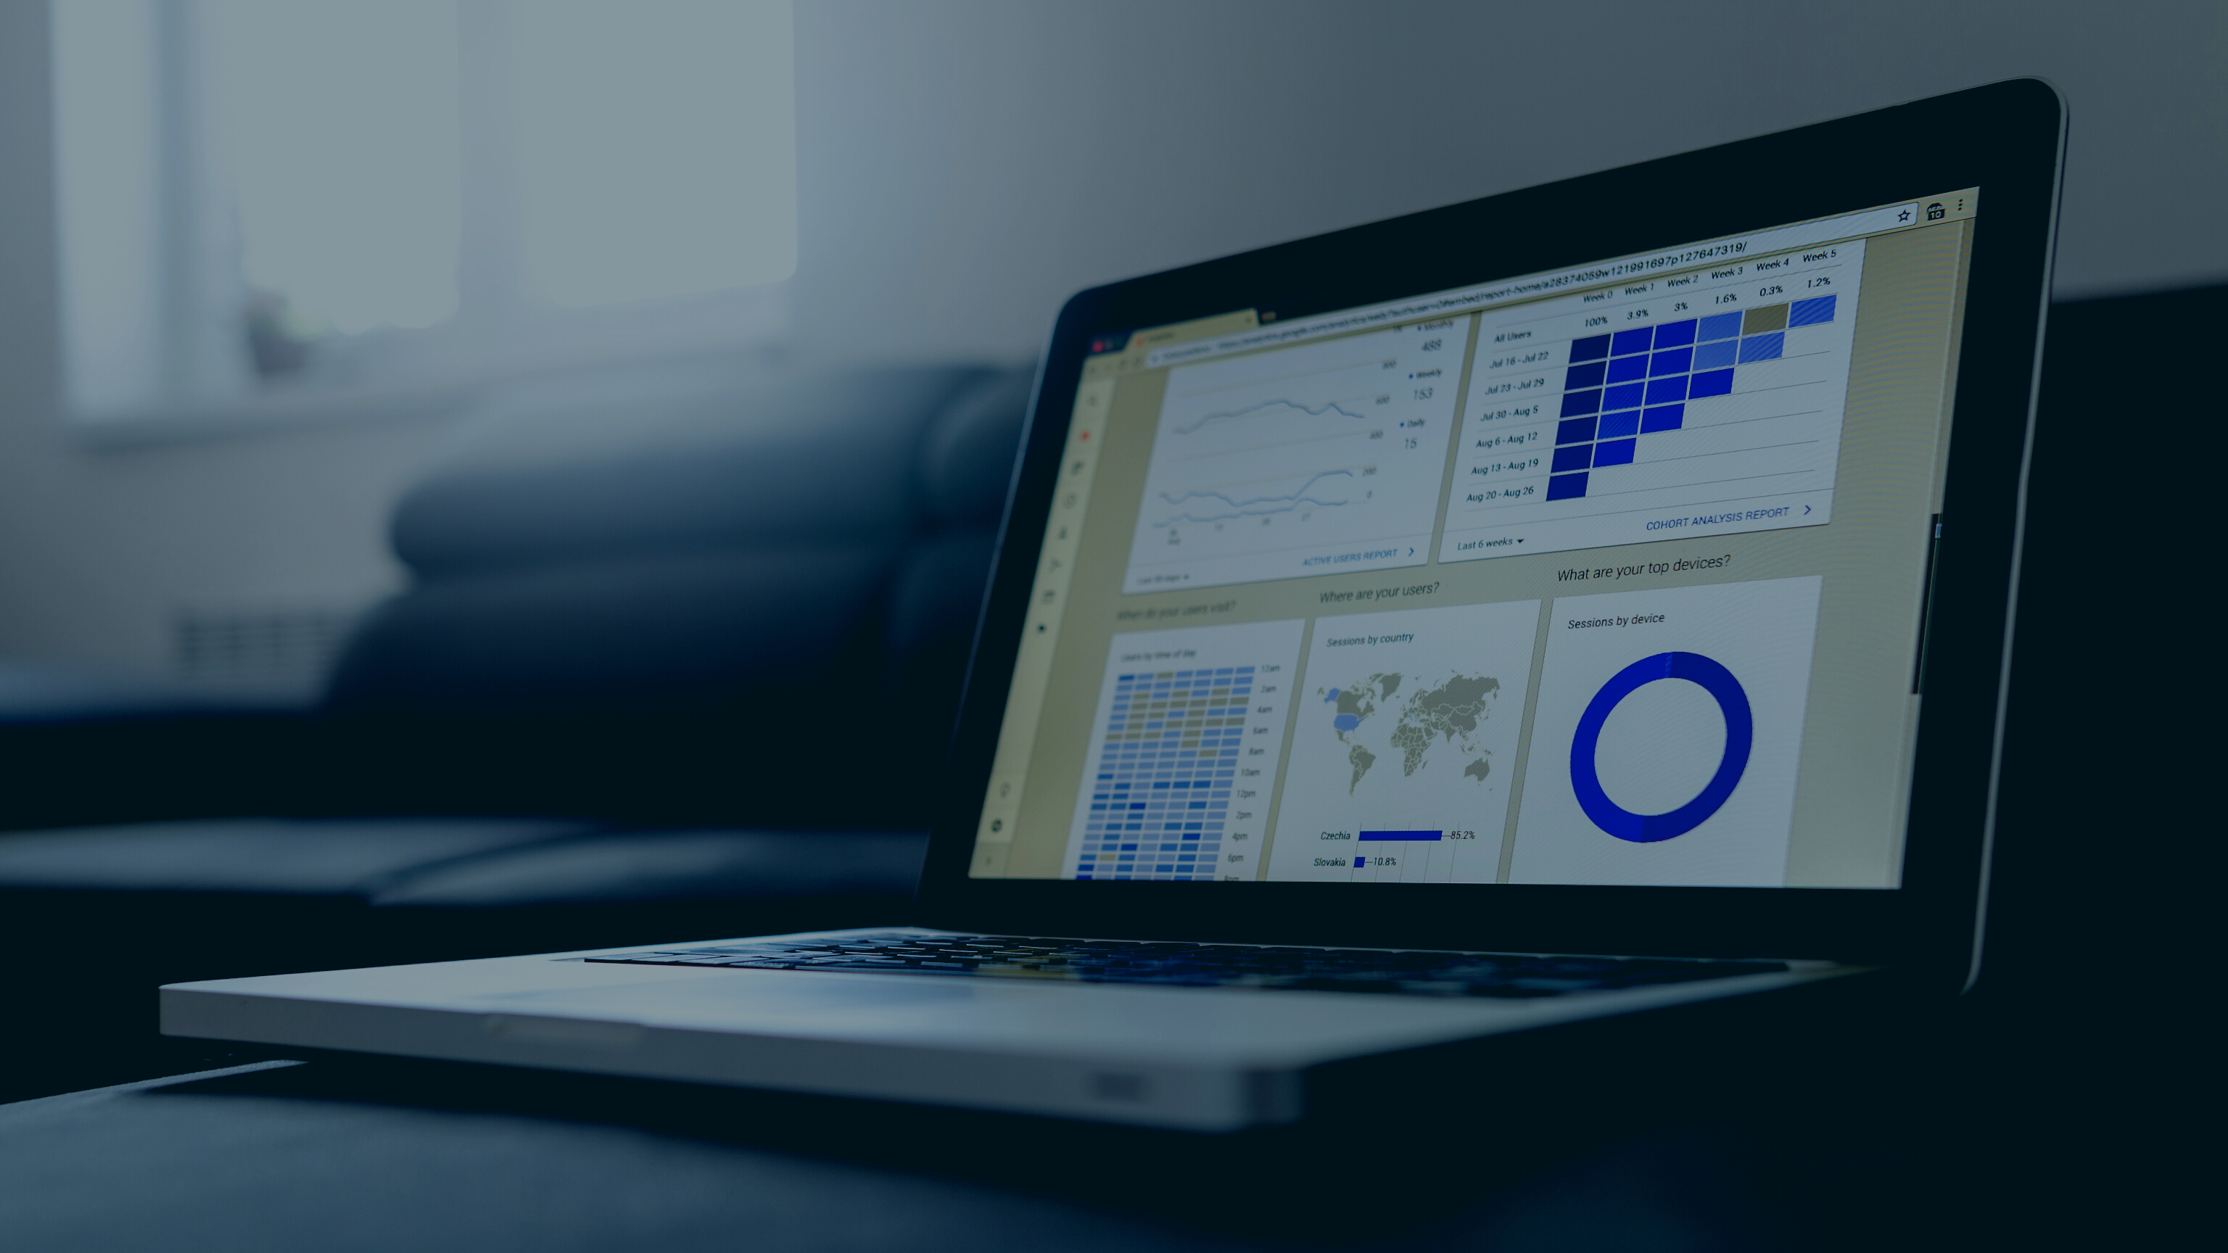
CUSTOMER ANALYTICS
Data Analytics Project
Presenting By Saif Ullah

Slide 2
04
ABOUT DATA
Our dataset includes the following information
Product Information: Product ID, Product Name, Quantity, Discount, Category and Sub-Categories
Customers information: Customer Name and Customer ID
01
02
Notes:
Data Link: https://docs.google.com/spreadsheets/d/1ymtUDxEmvicQRNyYTnxamNFgC8mUuvKH/edit?usp=sharing&ouid=110763270853539492449&rtpof=true&sd=true

Slide 3
05
ABOUT DATA
Our dataset includes the following information
Order Details: Order ID, Order Date, Ship Date and Ship Mode
Other: Location’s, Sales and Profit
03
04

Slide 4

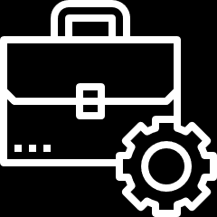
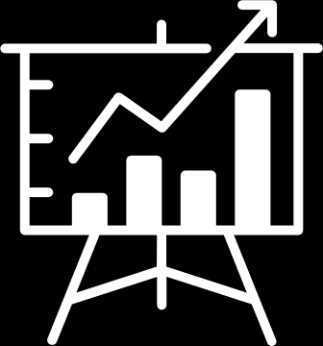
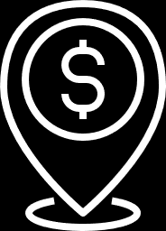
What Does It show?
06
Store Dataset helps:
Explore the profitability of different regions
Identify the country that has the highest sales, order count, and customer base.
Discover the most utilized shipping method
Get a comprehensive tally of customers utilizing each shipping mode

Slide 5
07
Cont.…
Store Dataset helps:
Count the number of customers in each segment
Which segment method is mostly use by customer’s
What is the range of customer spending?

Slide 6
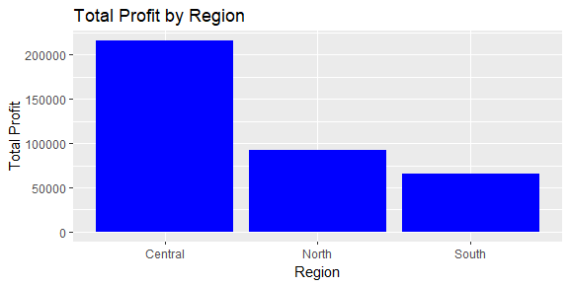

09
Explore the profitability of different regions
The graph illustrates the profits of each region, revealing that the central region has the highest profit

Slide 7
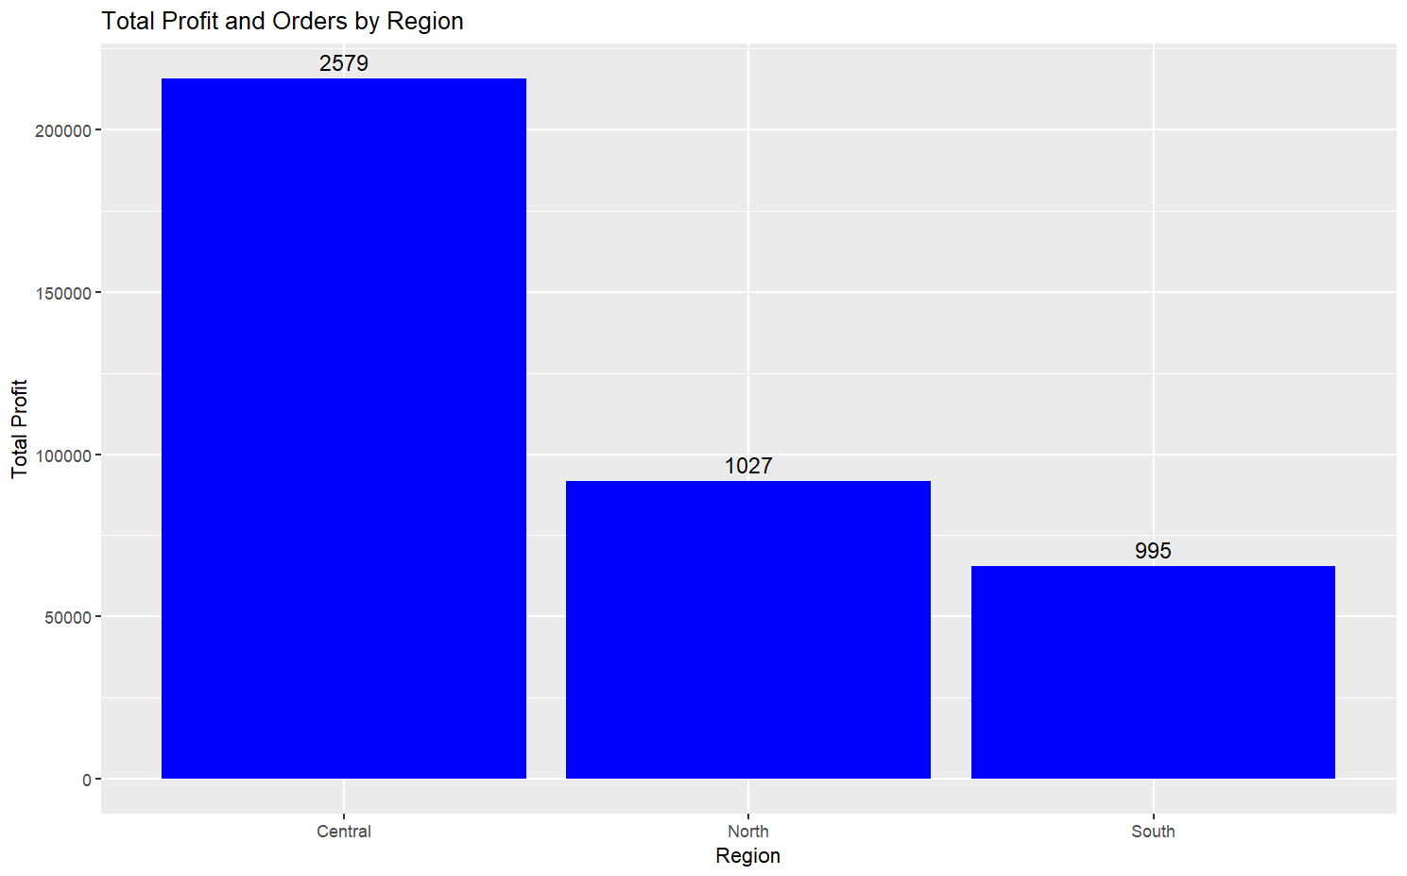
10
Cont.…
The reason for the central region's higher profit is due to its greater number of orders in comparison to other regions.

Slide 8

11
Take away
Among the three regions, the central region is the most significant for the business regarding revenue generation, as it has a higher number of orders and profits in comparison to the other regions

Slide 9
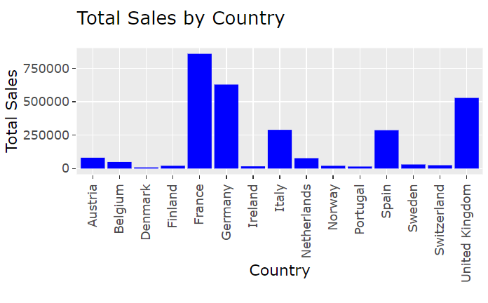
12
Uncover the top-performing countries in terms of sales, orders, and customer base
The graph illustrates the sales of each country, revealing that the France has the highest sales

Slide 10
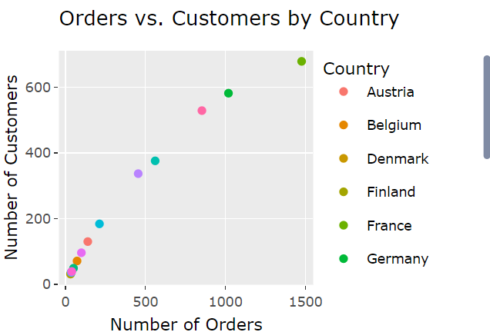
13
Cont.….
Irrespective of other countries, France also has the highest number of orders and customers.

Slide 11

14
Recommendation
France appears to be a strong performer in terms of profit, orders, and customers. If this trend continues, then it may be worthwhile to focus on expanding and optimizing operations in France to further capitalize on this success.

Slide 12
15
Discover the most utilized shipping method
According to our data we are shipped product by four method:
First Class
Same Day
Second Day
Standard Class
But customer mostly used by Standard Class.

Slide 13
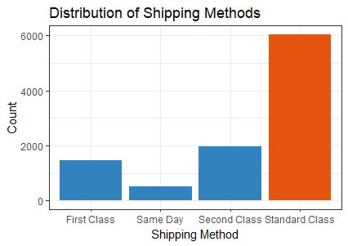
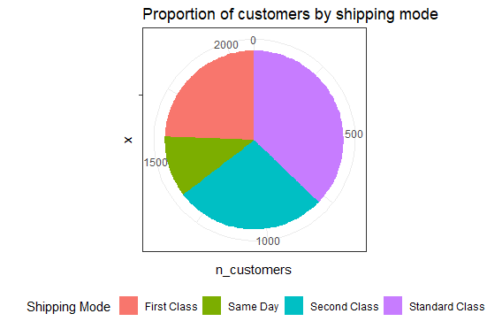
16
Cont.….

Slide 14
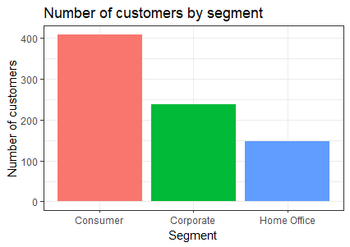
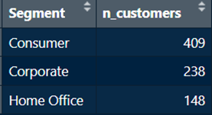
17
Count the number of customers in each segment
Our data categorizes customers into three segments namely:
Consumer
Corporate
Home Office

Slide 15
18
Recommendation
Mostly customer belongs to Consumer Segment, This could indicate that your store's products or services are geared towards individual consumers, and that your marketing and sales strategies are effective in targeting and appealing to this type of customer.

Slide 16

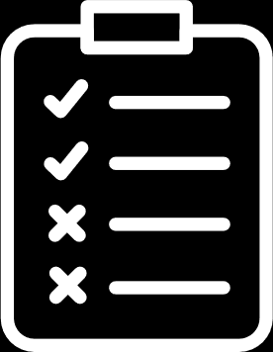
19
RFM Analysis

Slide 17
20
Recency: How many days have passed since the last purchase?
R
RFM Analysis
RFM is an analysis method used to identify a business’s best customers based on their spending habits. This analysis helps create segments of “important customers.”
Frequency: How many transactions did a customer do?
F
Monetary value: How much money did the customer spend?
M

Slide 18
21
12
Calculate Recency (R), Frequency (F), and Monetary (M) values at the customer..
Calculate approximate quantile cutoff values for R, F, and M using the cut2() function. Quantiles divide the data into five equal parts.
Calculate the RFM score based on quantile cutoff values. For example, customers who are frequent buyers, have recently bought from you, and usually are spending a lot of money would get a score of 555: Recency (R) = 5, Frequency (F) = 5, Monetary (M) = 5.
Get RFM segment based on the RFM score (using RFM Matrix)
Step by step RFM segmentation algorithm

Slide 19
22
RFM Score (ID=AA-10315) = (R score*100) + (F score*10) + (M score)
=(5*100)+(1*10)+(1)
= 511
RFM Score (ID= AA-10375) = (R score*100) + (F score*10) + (M score)
= (1*100)+(1*10)+(1)
=111
RFM Score (ID= AA-10480) = (R score*100) + (F score*10) + (M score)
= (4*100)+(3*10)+(1)
=134
Calculate RFM Score
(R score*100) + (F score*10) + (M score)

Slide 20
Customer segment | Description
Champions | Recent purchase, frequent transactions, high spending
Loyal Customers | Often spend good money buying your products. Responsive to promotions
Potential Loyalist | Recent customers but spent a good amount and bought more than once
Recent Customers | Bought most recently, but not often
Promising | Recent shoppers but haven’t spent much
Customers Needing Attention | Above-average recency, frequency and monetary values. They may not have bought very recently though
About to Sleep | Below average recency, frequency, and monetary values. Will lose them if not reactivated
At Risk | They spent big money and purchased often. But the last purchase was a long time ago
Can’t Lose Them | Often made the biggest purchases but they haven’t returned for a long time
Hibernating | The last purchase was long ago. Low spenders with a low number of orders
Lost | Lowest recency, frequency, and monetary scores
Segmentation
12
Understanding Customer Segmentation

Slide 21
Segments | Scores
Champions | 555, 554, 544, 545, 454, 455, 445
Loyal customers | 543, 444, 435, 355, 354, 345, 344, 335
Potential loyalist | 553, 551, 552, 541, 542, 533, 532, 531, 452, 451, 442, 441, 431, 453, 433, 432, 423, 353, 352, 351, 342, 341, 333, 323
Recent customers | 512, 511, 422, 421, 412, 411, 311
Promising | 525, 524, 523, 522, 521, 515, 514, 513, 425, 424, 413, 414, 415, 315, 314, 313
Customers needing attention | 535, 534, 443, 434, 343, 334, 325, 324
About to sleep | 331, 321, 312, 221, 213
At risk | 255, 254, 245, 244, 253, 252, 243, 242, 235, 234, 225, 224, 153, 152, 145, 143, 142, 135, 134, 133, 125, 124
Can’t lose them | 155, 154, 144, 214, 215, 115, 114, 113
Hibernating | 332, 322, 231, 241, 251, 233, 232, 223, 222, 132, 123, 122, 212, 211
Lost | 111, 112, 121, 131, 141, 151
Segmentation
12
Understanding Customer Segmentation By RFM Score

Slide 22
25
Customer Segmentation

Slide 23
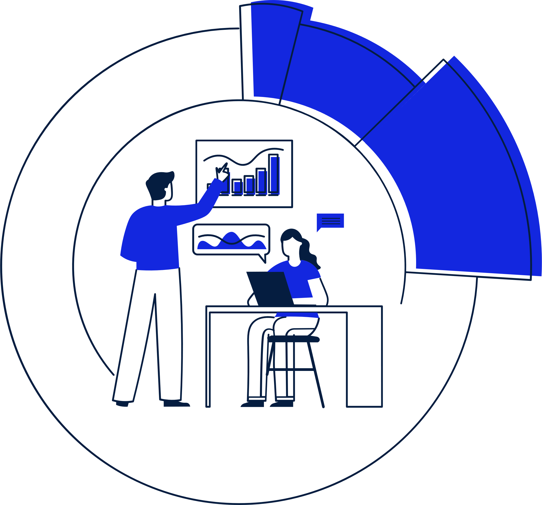
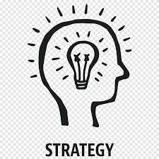
Customer Segmentation
26
Champion Customer’s
These are customers who have recently made a purchase, had a high frequency of transactions, and spend a lot of money with your business.
Focus on providing personalized experiences and rewards that reflect their spending habits. Offer exclusive promotions, early access to new products, or a loyalty program with additional benefits based on their spending.
]

Slide 24
Customer Segmentation
27
Loyal Customers
These are customers who frequently make purchases and often spend a significant amount of money with your business. They are also responsive to promotions.
Build a relationship with them by offering personalized experiences and rewards. Provide special offers that reflect their interests or buying habits, send exclusive content or promotions via email or social media, or offer a VIP membership with additional perks and benefits.
]

Slide 25
Customer Segmentation
28
Potential Loyalist:
These are customers who have made a recent purchase and spent a good amount of money, but have not yet established a consistent buying pattern.
Offer incentives and rewards that encourage repeat purchases. Provide personalized recommendations based on their previous purchases or send a follow-up email with additional product information or exclusive promotions.
]

Slide 26
Customer Segmentation
29
Promising
These are customers who have recently shopped with your business, but haven't spent much.
.
Encourage them to make additional purchases with special offers or promotions. Provide them with personalized recommendations based on their interests or previous purchases.
]

Slide 27
Customer Segmentation
30
Customers Needing Attention:
These are customers with above-average recency, frequency, and monetary values, but they may not have bought recently.
Send them personalized emails or messages with exclusive promotions or product recommendations. Offer them additional incentives to make a purchase.

Slide 28
Customer Segmentation
31
About to Sleep:
These are customers with below-average recency, frequency, and monetary values. They will be lost if not reactivated
Send them targeted emails or messages with exclusive offers or promotions. Offer them personalized recommendations or reminders to make a purchase.
]

Slide 29
Customer Segmentation
32
At Risk
These are customers who have spent a lot of money and purchased often in the past, but the last purchase was a long time ago.
Send them personalized emails or messages with exclusive offers or promotions. Remind them of the benefits of your products or services and encourage them to make another purchase.
]

Slide 30
Customer Segmentation
33
Can’t Lose Them
These are customers who have made the biggest purchases, but haven’t returned for a long time.
Send them personalized emails or messages with exclusive offers or promotions. Offer them special incentives or rewards to encourage them to make another purchase.
]

Slide 31
Customer Segmentation
34
Hibernating:
These are customers whose last purchase was a long time ago. They are low spenders with a low number of orders.
Send them targeted emails or messages with exclusive offers or promotions. Offer them personalized recommendations or reminders to make a purchase.
]

Slide 32
Customer Segmentation
35
Lost
These are customers with the very lowest recency, frequency, and monetary scores.
It may not be worth investing in a reactivation campaign for these customers. Instead, focus on attracting new customers and building brand awareness.

Slide 33

36
Conclusion
RFM model enables you to get a holistic view of existing customers. Hence, creating strategies to maximize the lifetime value of your customers
It used to help businesses rank and segment customers based on the recency, frequency, and monetary value of a transaction.

Slide 34
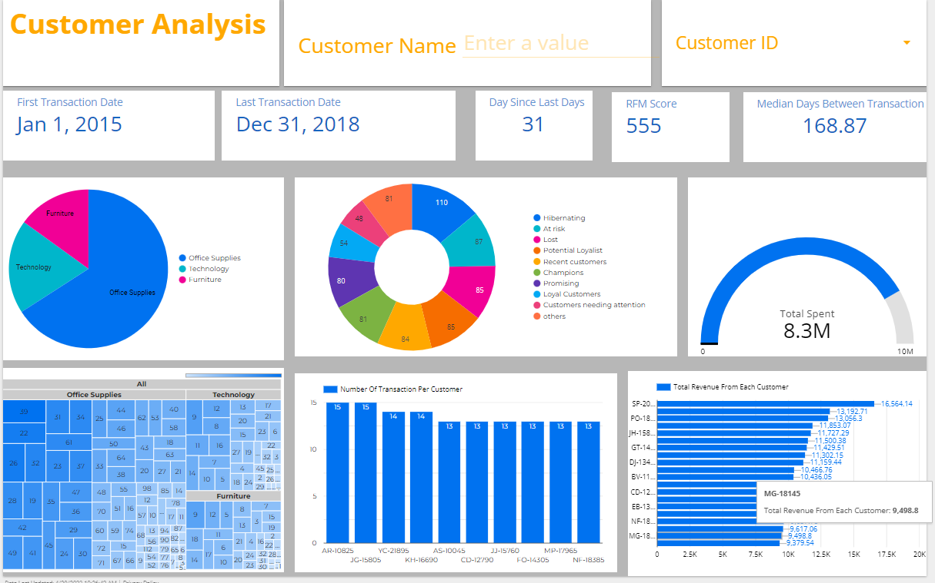
Dashboard
Notes:
Link:https://lookerstudio.google.com/reporting/663e8e18-0be4-4e1a-9556-65843741d384

Slide 35
38
Thank You

